Slide 1
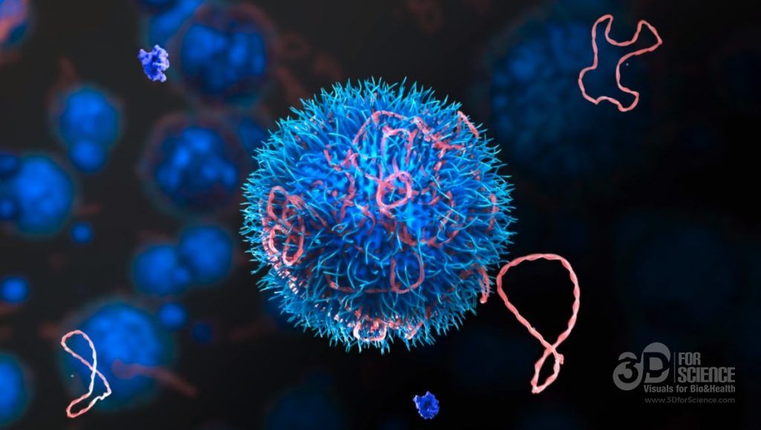
Mechanisms of Action(MoA) Prediction
final phase
Haoyu Guo
Xinbo Xia
Rocha Zhou
Notes:
Slides can vary as per your presentation, but header and footer should be consistent

Slide 2

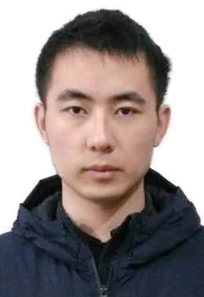
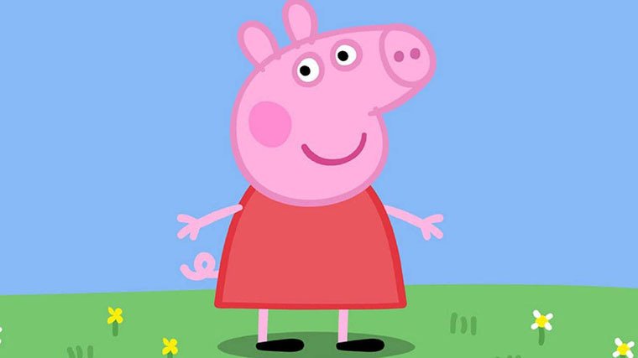
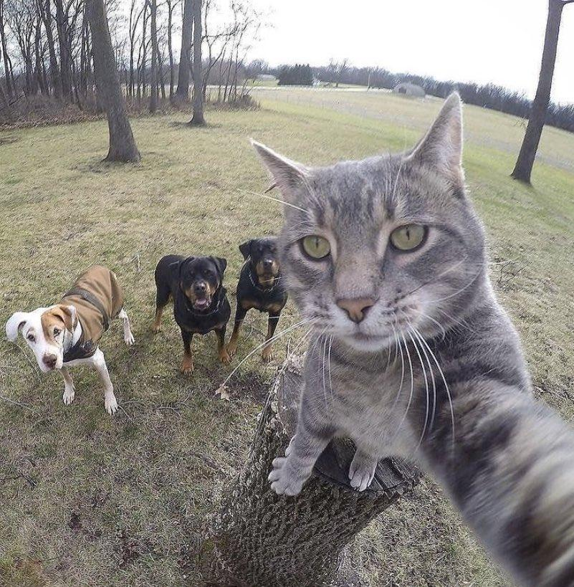
ABOUT
Department of Electrical and Computer Engineering
University of Southern California, Los Angeles, CA
https://github.com/guohaoyu110/EE542_final
Haoyu Guo
Xinbo Xia
Rocha Zhou
Graduate Student
Graduate Student
Graduate Student

Slide 3
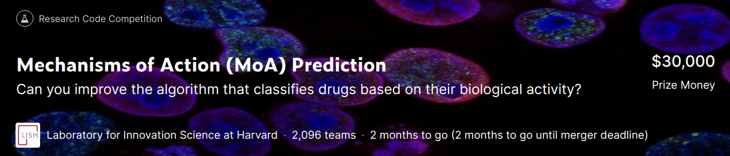
About Kaggle Platform
Biggest platform for competitive data science in the world
Great platform to learn about the latest techniques and avoiding overfit
Great platform to share and meet up with other data freaks

Slide 4
10 rules of Kaggle
Invest your time(a good tradeoff between time and skill)
Use a good software
Do your research
Look into the data
Understand the measure(MAE, MSE)
Validate your model(several CV folds, repeated CV folds)
Tune your model(e.g XGboost, bayesian optimization)
Think of new features
Remove noisy features
Ensemble different models

Slide 5
Background
Mechanism of Action (MOA) refers to the specific biochemical interaction through which a drug substance produces its pharmacological effect.
Believe or not, for many widely used drugs such as Robaxin(pain reliever), Glucophage(treatment of diabetes), scientists have no idea how these drugs react with human cells and why they work, only knowing that these drugs have certain functionalities.
Not fully understanding MoA of drugs could produce potential danger. If something of that drug goes wrong, it will be difficult to solve the problem. What’s more, understanding MoA of drugs can provide a more reliable way to invent new drug.

Slide 6
Why MoA important?
In the past, scientists have derived drugs from natural products and have been inspired by tradition remedies.
Today, with the advent of more powerful technologies, drug discovery is shifting from past serendipitous approaches to more targeted models based on an understanding of the biological mechanisms underlying the disease. In this new framework, scientists seek to identify identify disease related protein targets and develop molecules that can regulates those protein targets. As an abbreviation to describe the biological activity of a particular molecule, scientists assign a label called MoA for short.

Slide 7
How to evaluate the accuracy of solution?
Based on the MoA annotation, the accuracy of the solution is evaluated based on the mean value of the log loss function applied to each drug MoA annotation pair.
if successful, we will contribute to the development of algorithms that predict the MoA of the cell-signed compound, helping scientists advance the drug discovery process.

Slide 8
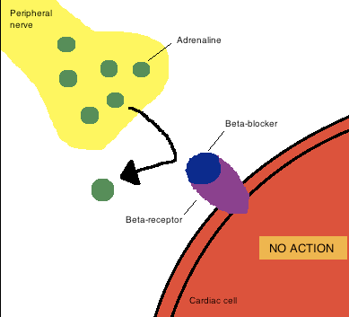
Example of MoA
Beta blockers exert their pharmacological effect, decreased heart rate, by binding to and competitively antagonising a type of receptor called beta adrenoceptors
Adrenaline: a kind of hormone that increases heart rate

Slide 9
Motivation
One of the biggest obstacles that impedes the development of MoA is that genomic data is so versatile(so many gene expressions) and unorganized. So it’s difficult to use traditional experimental method to test and classify the MoA.
However, with the help of machine learning, classifying MoA based on complicated genomic data becomes practical. With the data from MIT/Harvard Lab, we developed MoA prediction algorithms to classify MoA.

Slide 10
Model Overview
raw data
1) Feature Engineering
cleaned data
2）Model Selection
Neural Network
Basic NN
3) Use three different models
Weighted Results
4) Model Interference
TabNet
DNN
5) Prediction Results

Slide 11
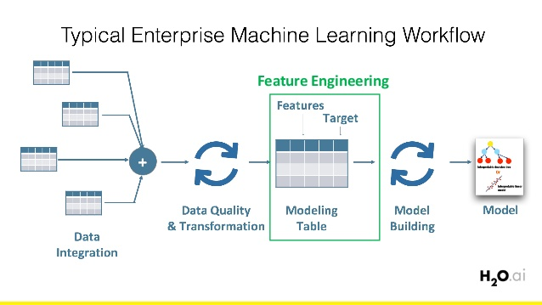
Feature Engineering
Feature engineering is the process of transforming raw data into features that better represent the underlying problem to the predictive models, resulting in improved model accuracy on unseen data.

Slide 12
Raw Data
File | Shape | Comment
train_features.csv | (23814, 876) | training features
test_features.csv | (3982, 876) | testing features
train_targets_ scored.csv | (23814, 207) | target file
train_targets_ nonscored.csv | (23814, 403) | ancillary data set
submission.csv | (3982, 207) | submission file

Slide 13
Features
3 cp features:
cp_type (trt_cp and ctl_vehicle)
cp_time: treatment time(24, 48, 72 hours)
cp_dose: dose(D1 and D2)
gene expressions: starting with g-, 0 - 771
cell viability data: starting with c-, 0 - 99

Slide 14
Feature Engineering
With nearly 900 features, obviously, not all of them are useful in model training. Some of them might be highly correlated and some of them might be completely uncorrelated. Before proceeding to training phase, dimension reduction must be done in advance.

Slide 15
Feature Engineering flowchart
Reduce Dimension
Raw Data
Rank
Gauss
PCA
Set Threshold
Variance Threshold
Output
Training
normalize

Slide 16
RankGauss
RankGauss is a popular method for feature extraction and is used to normalize input data. It’s based on rank transformation. First step is to assign a linspace to the sorted features from 0...1, then apply the inverse of error function to shape them like gaussians, then we subtract the mean. And this works usually much better than standard mean/std scaler or min/max.
Notes:
http://fastml.com/preparing-continuous-features-for-neural-networks-with-rankgauss/
First, let me explain what is the rankgauss method

Slide 17
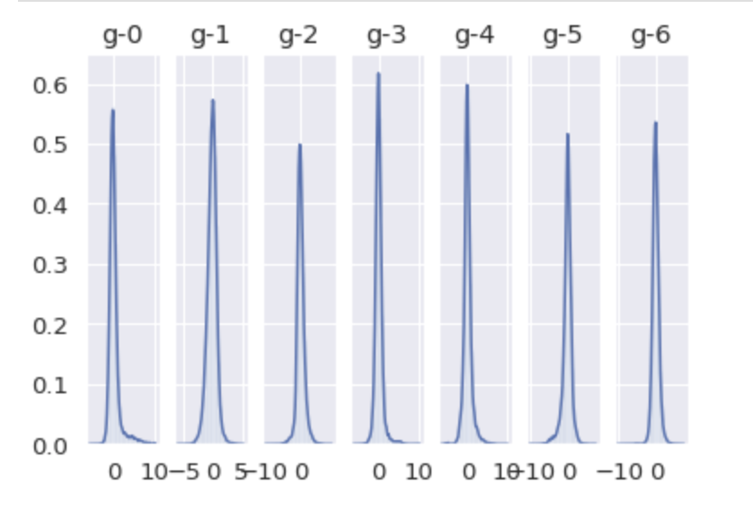
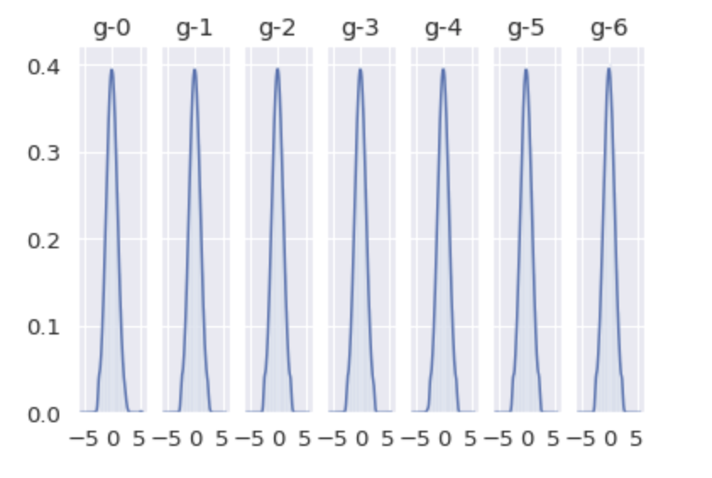
RankGauss
Before RankGauss After RankGauss
Notes:
It appears that we were able to transform the distribution of each data to resemble a normal distribution, as intended. So, let’s enter the data into the benchmarking method to see the improvement.

Slide 18
PCA
Principal Component Analysis is one of the easiest, most intuitive, and most frequently used methods for dimensionality reduction, projecting data onto its orthogonal feature subspace.
It is used as:
Pre-processing method before classification to reduce computational costs of the classifier.
Compression method for ease of data storage and retrieval.
Feature extraction method

Slide 19
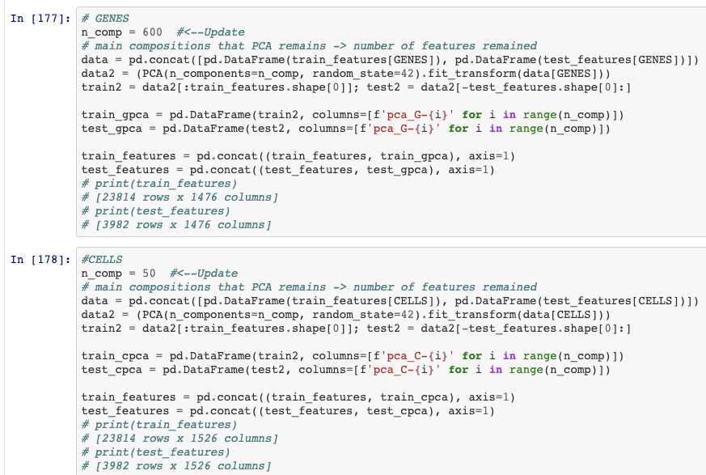
After PCA
N_comp: number of components to keep. If n_components is not set, all components are kept.
Random_state: pass an int value for reproducible results across multiple function calls.
Fit_transform/fit: for fit_transform (X[,y]), it fit the model with X and apply the dimensionality reduction on X; For fit, it fits the model with X.

Slide 20
Variance threshold
Variance threshold from sklearn is a simple baseline approach to feature selection. It removes all features which variance doesn't meet some threshold. By default, it removes all zero-variance features, i.e., features that have the same value in all samples.
Motivated by the idea that low variance features contain less information
Calculate variance of each feature, then drop features with variance below the threshold
Make sure that features have the same scale

Slide 21
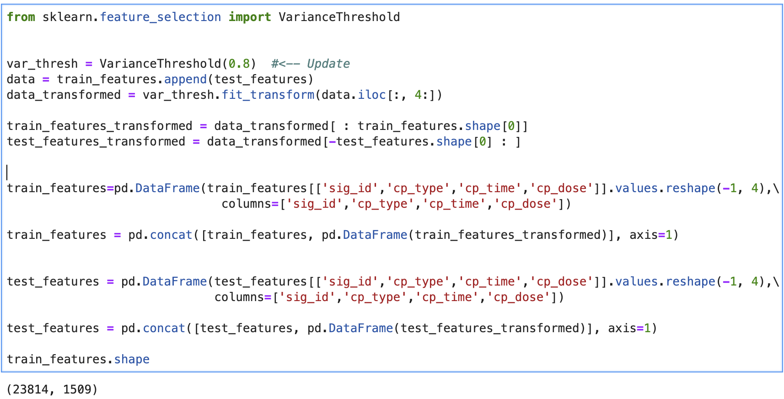
Variance Threshold
We set threshold value to be 0.8, which means that we drop data below varaince of 0.8.

Slide 22
Model 1 Overview
Batch Normalization
Input
k-means
Clustered Data
optimization
Scheduling
during training
Label Smooth
NN
K-Folds CV
Accuracy
Model

Slide 23
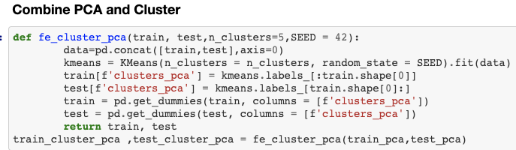
K-means
We set clusters for genes to be 22 and clusters for cells to be 4. (determined by Elbow Method and Silhouette Coefficient method).
Then, we further cluster the combined data and combine with PCA.

Slide 24
Batch normalization
Why Batch normalization?
Using batch normalization makes the neural network more stable during training
This may require the use of much larger than normal learning rates, that in turn may further speed up the learning process
And this is why we use scheduler to tune the learning rate later
How does batch normalization work?
Batch normalization normalizes the output of a previous activation layer by subtracting the batch mean and dividing by the batch standard deviation.
Batch normalization lets SGD do the denormalization by changing only these two weights for each activation, instead of losing the stability of the network by changing all the weights.

Slide 25
Forward and backward propagation
These are two most common and important procedures in training neural network model.
Forward propagation refers to the calculation and storage of intermediate variables (including outputs) for a neural network in order from the input layer to the output layer.
While backward propagation is in reverse calculation order and is calculating gradient values based on values from forward propagation.

Slide 26
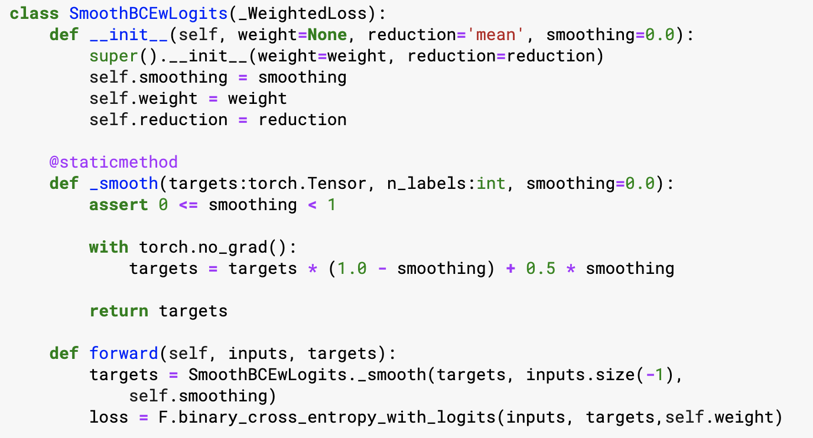
Label Smoothing
When using deep learning models for classification tasks, we usually encounter the following problems: overfitting, and overconfidence. Basically, Label smoothing is a regularization technique that addresses both problems.

Slide 27
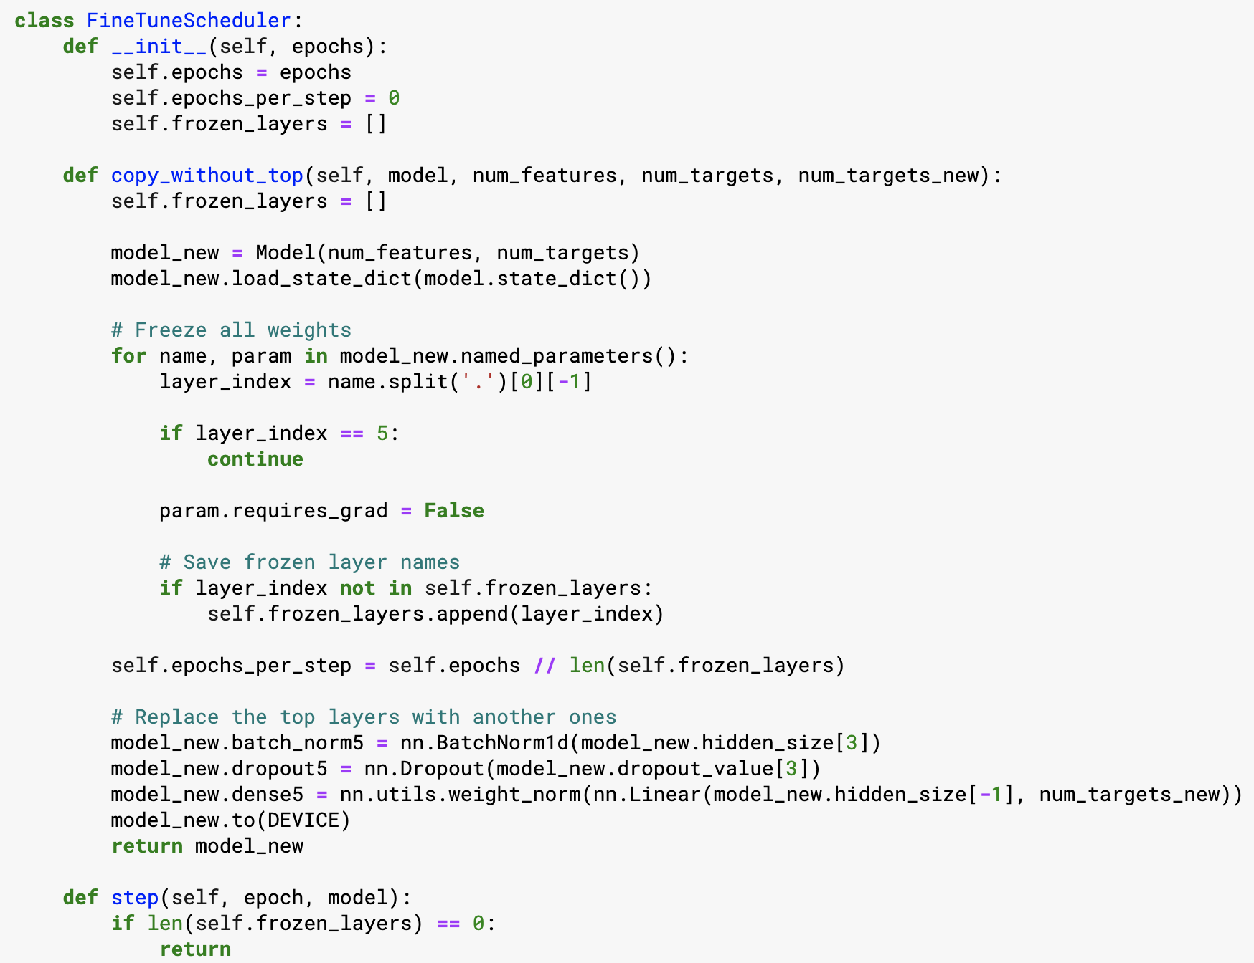
Scheduler
Basically ,it is used to slow down learning rate to potentially get better results.

Slide 28
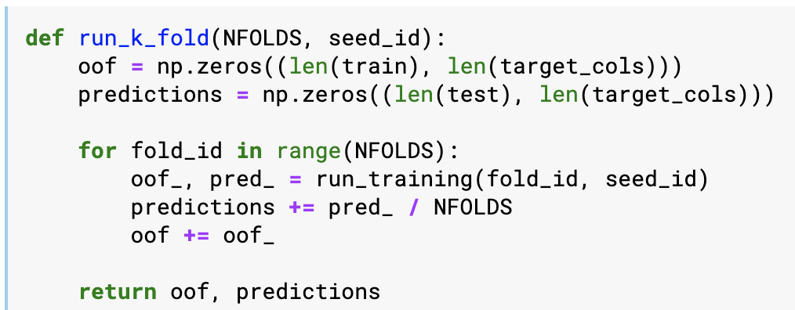
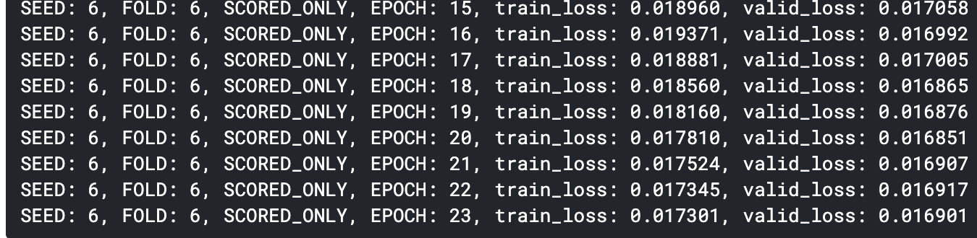
k-folds CV

Slide 29
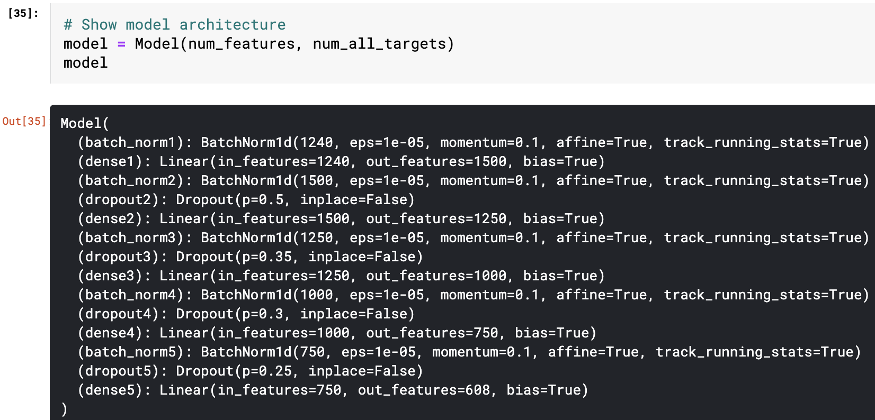
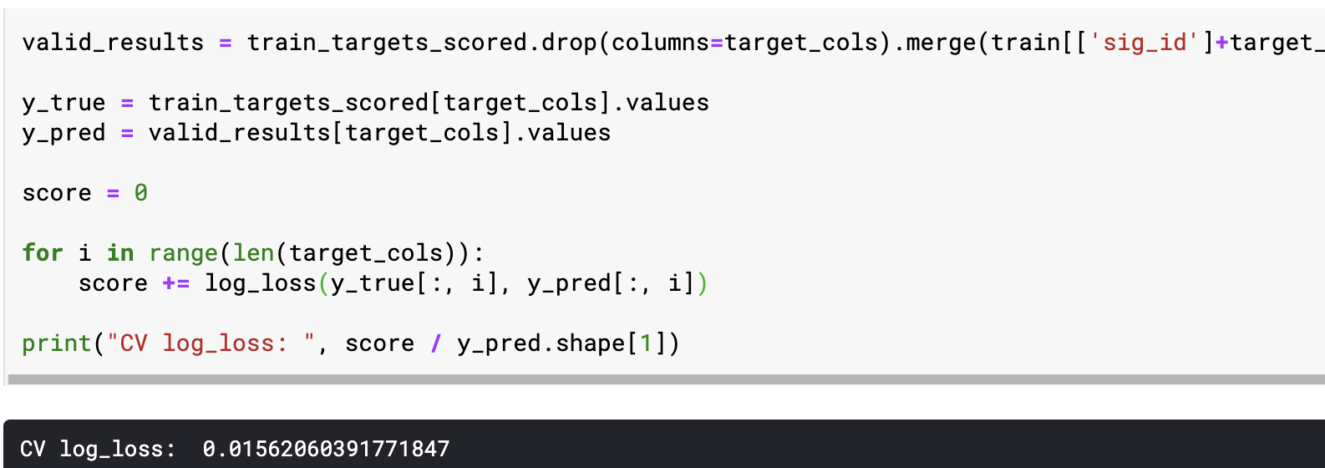
Model and results

Slide 30
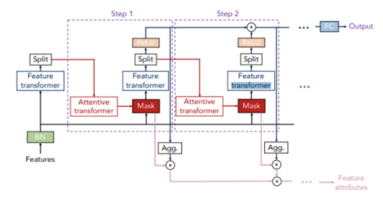
Model 2 (TabNet Model) Overview
We learned this model from Reference # 1,7

Slide 31
TabNet
TabNet uses a kind of soft feature selection to focus on just the features that are important for the data and this is accomplished through a sequential multi-step decision mechanism. Each step will produce part of the output and finally concat all output.
Important composition:
Feature transformer(take Batch Normed data as input, then give selected features to AT, and produce part of the predictions too)
Attentive transformer(take features, create mask)
Mask(sparseMax)

Slide 32
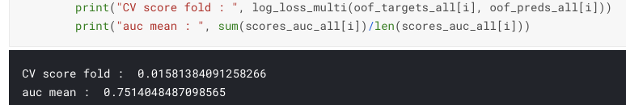
Details and Results
General architecture is shown in previous slide. We defined TabNet Model and TabNet Regressor and saved our trained model for validation. Same as Model 1, we use optimizer and scheduler during training for optimization and use K-folds CV to validate the model after training.

Slide 33
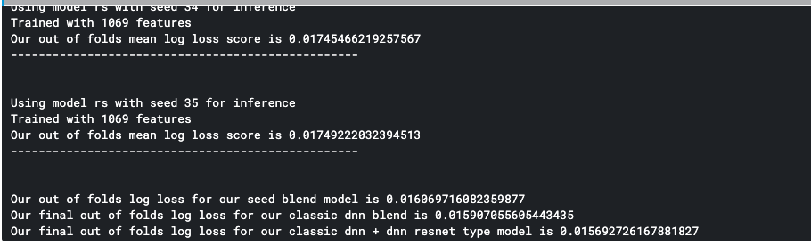
Model3: DNN
Create 5-layer, 4-layer, 3-layer, 2-layer and Resnet-type model
Train our DNN model
Run the model with multiple seeds and average the predictions
Blend 5-layer, 4-layer, 3-layer and 2-layer DNN model
Blend the result of the previous model with DNN resnet type model
We learned this model from Reference # 4
Notes:
4. in turns of blending, that’s to say we do the average of these four models; we get the mean log loss of this value ; and we get this average of all four predictions

Slide 34
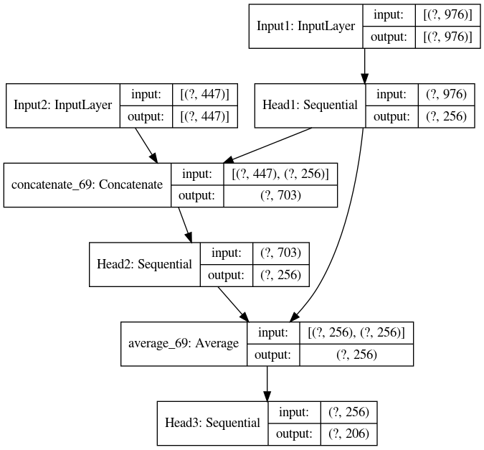
Resnet type model

Slide 35
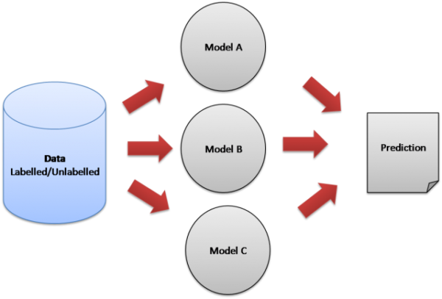
Model Ensembling
Voting
Averaging
Bagging
Boosting
Binning
Blending
Stacking
Notes:
in today’s kaggle competition, it’s almost impossible to get a good grade without using model ensembling

Slide 36
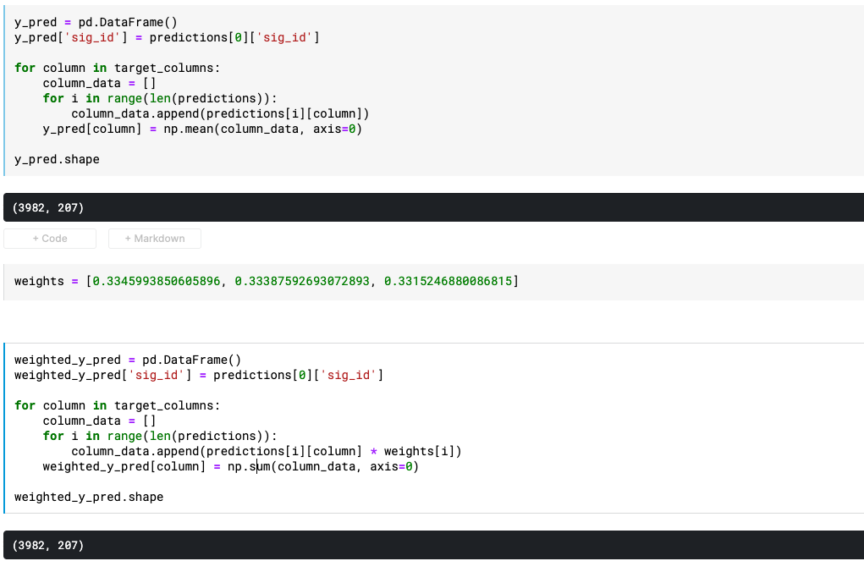
Model ensemble
Blending!
Notes:
there are two kinds of blending. The blending i used before is uniform blending, it’s like absolute democracy, everyone has the same power, the same weight; and another kind is this one, i set up different weights to compare, it’s like electoral college, people in Wyoming has more power than people in calfornia to determine a senator or a president.

Slide 37
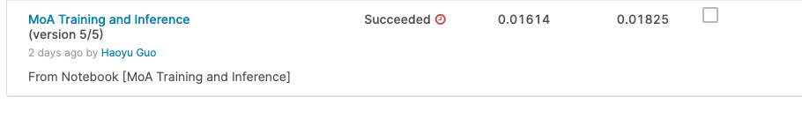
Final Result
Notes:
how do we get the final result

Slide 38
Evaluation
Based on the MoA annotations, the accuracy of solutions will be evaluated on the average value of the logarithmic loss function applied to each drug-MoA annotation pair.
if successful, you’ll help to develop an algorithm to predict a compound’s MoA given its cellular signature, thus helping scientists advance the drug discovery process.

Slide 39
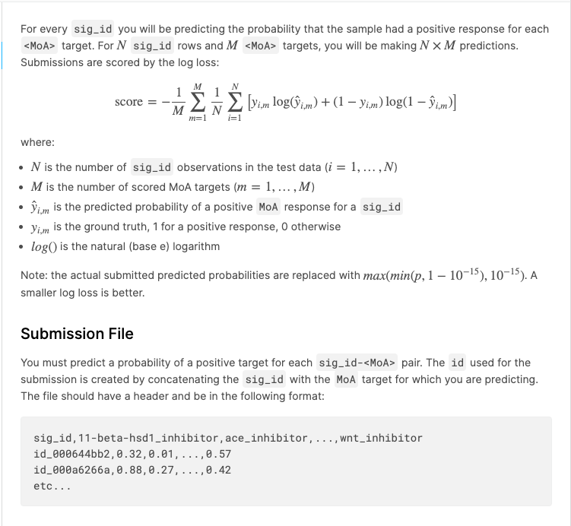
Evaluation
Notes:
how to evaluate the accuracy of a solution?

Slide 40
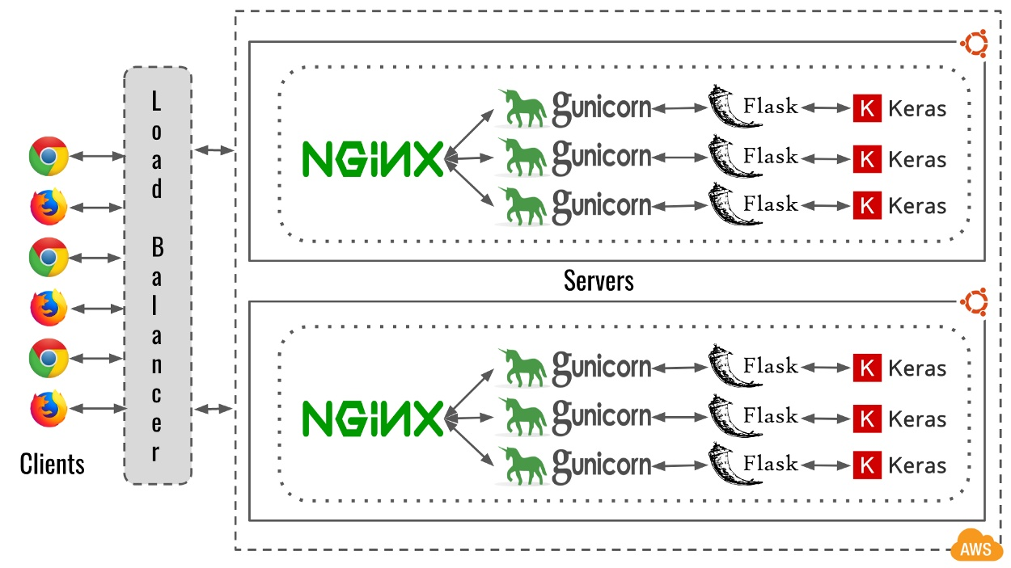
Future Work
Deploy to AWS and edge devices

Slide 41
Reference
https://www.youtube.com/watch?v=ysBaZO8YmX8 (tabnet model)
https://github.com/microsoft/WSL/issues/6014
Hyperparameter tuning with Keras Tuner
https://www.kaggle.com/ragnar123/moa-dnn-feature-engineering
Competition insights
Model blending optimization
https://www.groundai.com/project/tabnet-attentive-interpretable-tabular-learning/1

Slide 42
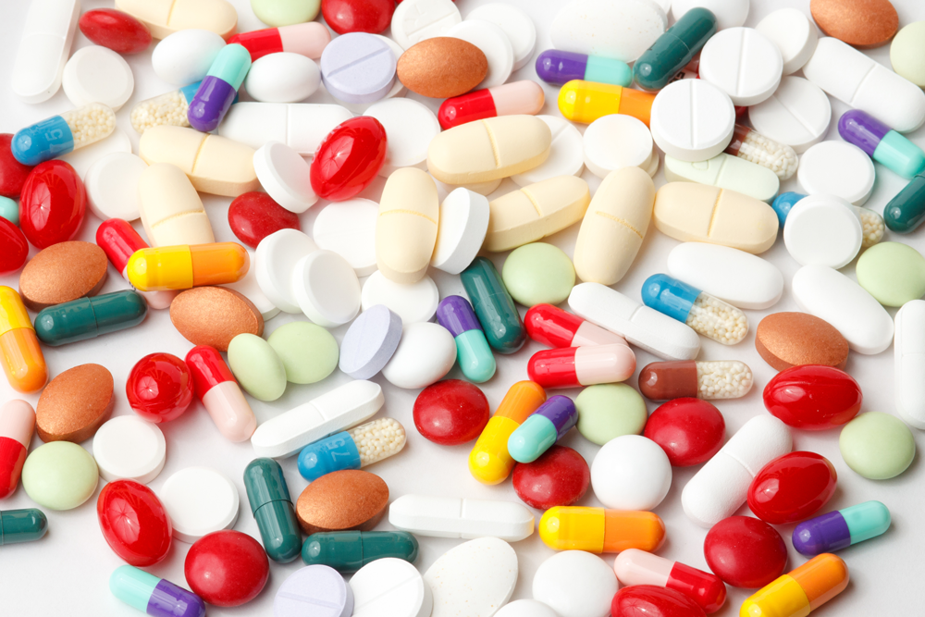
Thank you!

